Slide 1

SPRING BOOT
-Aishwarya Sawant ☺

Slide 2
WHAT IS SPRING BOOT?
Takes an opinionated view of building Spring applications.
Gets you up and running as quickly as possible.

Slide 3
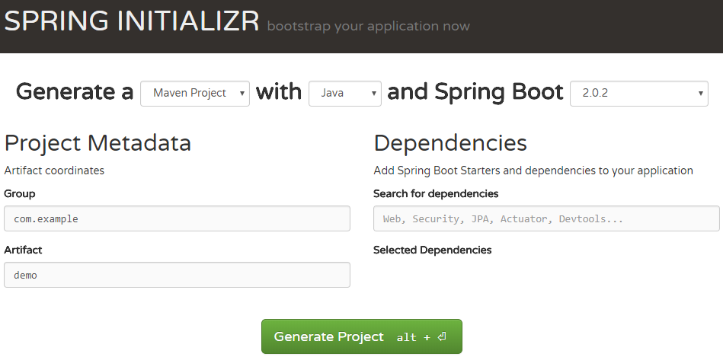
To make a Spring Boot Project

Slide 4
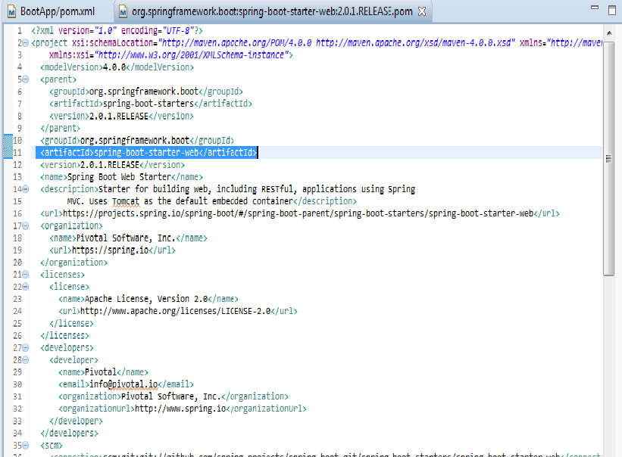
Inside starter-web…k

Slide 5
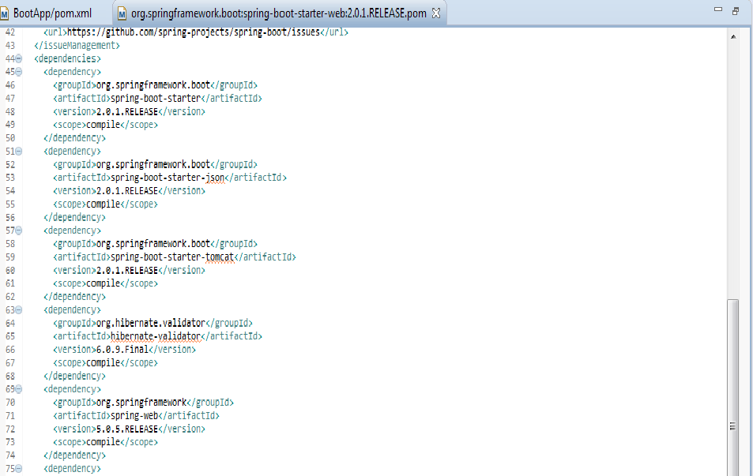
Spring Boot has an embedded server

Slide 6
WHY SPRING BOOT?

Slide 7

What Spring Does?
<bean name="customerDao" class="com.day6.dao.CustomerDaoImpl">
</bean>
<bean name="customerService" class="com.day6.service.CustomerServiceImpl">
<!-- <property name="custDao" ref="customerDao" ></property> -->
<constructor-arg index ="0" ref="customerDao"></constructor-arg>
</bean>

Slide 8
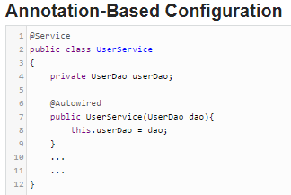
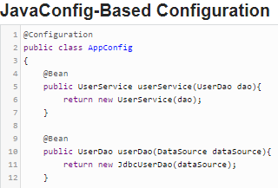

Slide 9
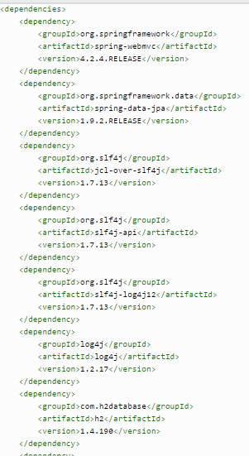
pom in spring

Slide 10
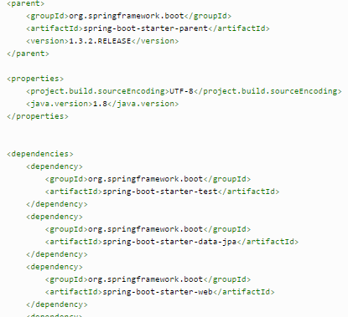
What Spring Boot pom Looks Like..

Slide 11
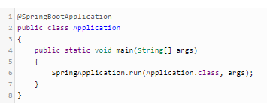
Spring Boot Entry Point Class

Slide 12
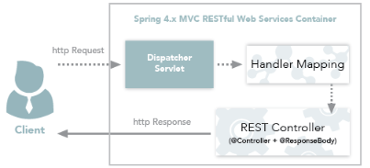
Annotations
RestController

Slide 13
Annotations
SpringBootApplication
EnableAutoConfiguration
ComponentScan

Slide 14
THANK YOU!! ☺

